Slide 1
WALNUT: Waging Doubt on the Integrity MEMS Accelerometers with Acoustic Injection Attacks
Timothy Trippel, Ofir Weisse, Wenyuan Xu, Peter Honeyman, Kevin Fu

Slide 2
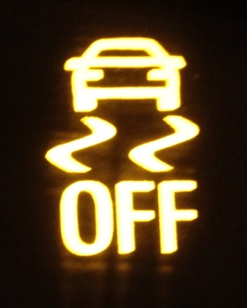
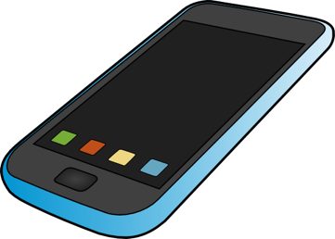

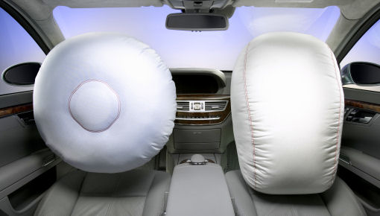
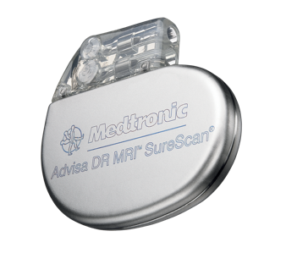
Sensors Drive Autonomous Systems
Should we trust sensors?
Notes:
Sensors are devices that measure environmental stimuli and are deployed in …

Slide 3
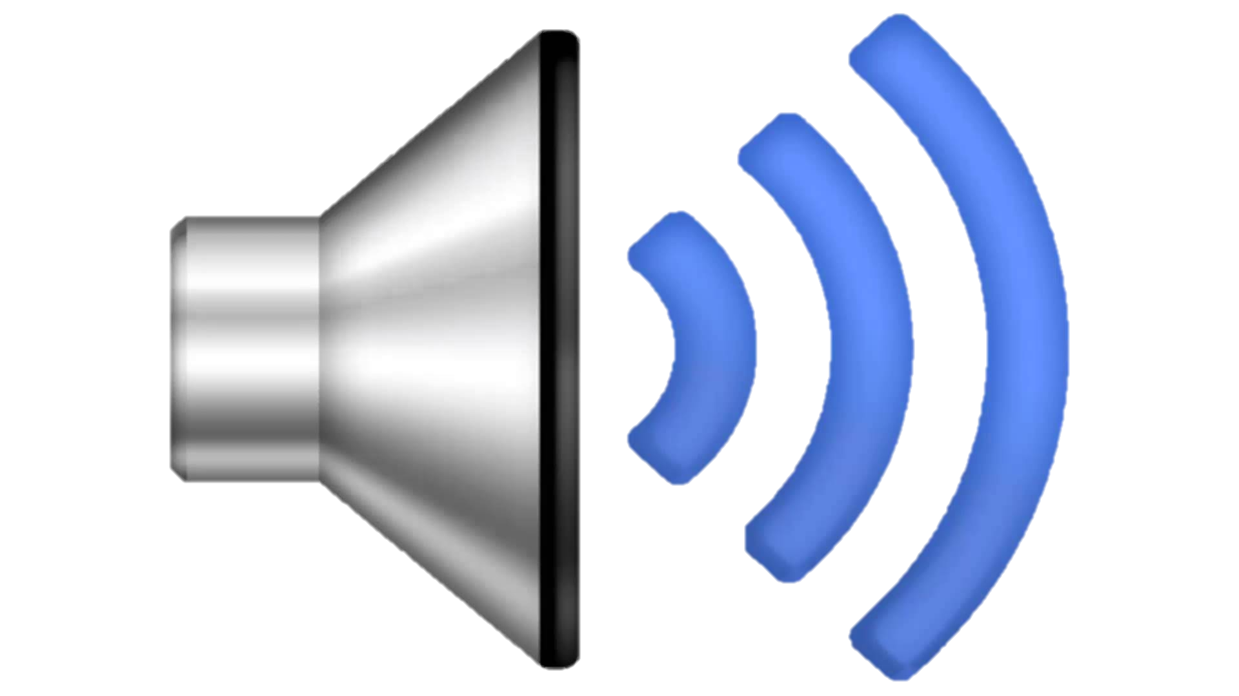
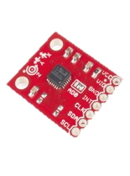
Consider an Adversary?
Notes:
Imagine the following scenario... you are riding along in your car that uses a MEMS accelerometer sensor to autonomously deploy the airbags.
An adversary has taken control of the car's entertainment system and is playing strange acoustic tones.
It turns out...
.................
The main questions I addressed in this research were:
Can an adversary control the output of a sensor (specifically MEMS accelerometers) and modify the behavior of an autonomous system?
What can we do to ensure the safety and integrity of cyber-physical systems?

Slide 4
Overview
Spoofing MEMS accelerometers acoustics
Controlling an accelerometer’s output
Infiltrating an autonomous system via its sensors
Defending accelerometers from acoustic attacks

Slide 5
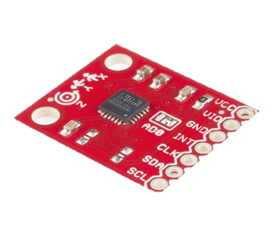
MEMS Sensors
Micro-Electro-Mechanical Systems
Accelerometers
Gyroscopes
Etc.
Advantages:
Low Cost – easy to manufacture
Low Power – some < 1 mA
Small Size – integrated circuit
IC Package
MEMS Accelerometer*
*Photos courtesy of “MEMS Accelerometers – Seminar”, by Matej Andrejašič.

Slide 6
How Acoustics Spoof MEMS Accelerometers

Slide 7
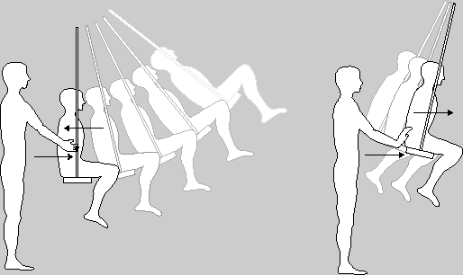
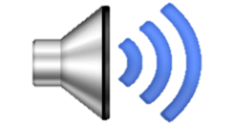
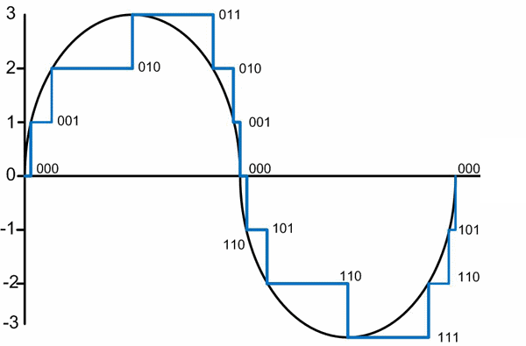
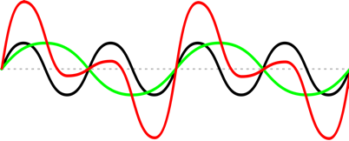
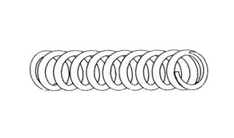
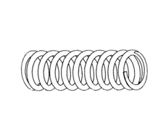

Acoustics Affect Accelerometers
1. Signal Generation
2. Signal Processing
Resonant Frequency
Sensing
Mass
Capacitance→
Voltage
LPF
ADC
Acceleration = s(t)
A₁s_{a}(t)
Amplifier
MEMS Component
MEMS Component
+ + + + + + + + + +
+ + + + + + + + + +
+
+
Variable
Capacitor
Variable
Capacitor
ŝ(t) = s(t) + A₁s_{a}(t)
-
-
-
-
-
-
-
-
-
-
-
-
-
-
-
-
∆Capacitance
s(t)
Capacitance → Voltage
-
-
Sensing
Mass
Sensing
Mass
d(t)

Slide 8


How Common is this Vulnerability?
40 Accelerometers
20 Models
5 Manufacturers
Frequency Sweep
0 – 30 kHz
50 Hz Interval
256 Samples
Standard Deviation
Mean
Acoustic Isolation Chamber
Sound
Amplifier
Mechanically
Decoupled
Function Generator
Accelerometer
5 kHz
Notes:
We looked at a sufficient number of devices to notice some are and some are NOT vulnerable
1. What is the Resonant Frequency?
2. How does False Acceleration Manifest Itself?

Slide 9
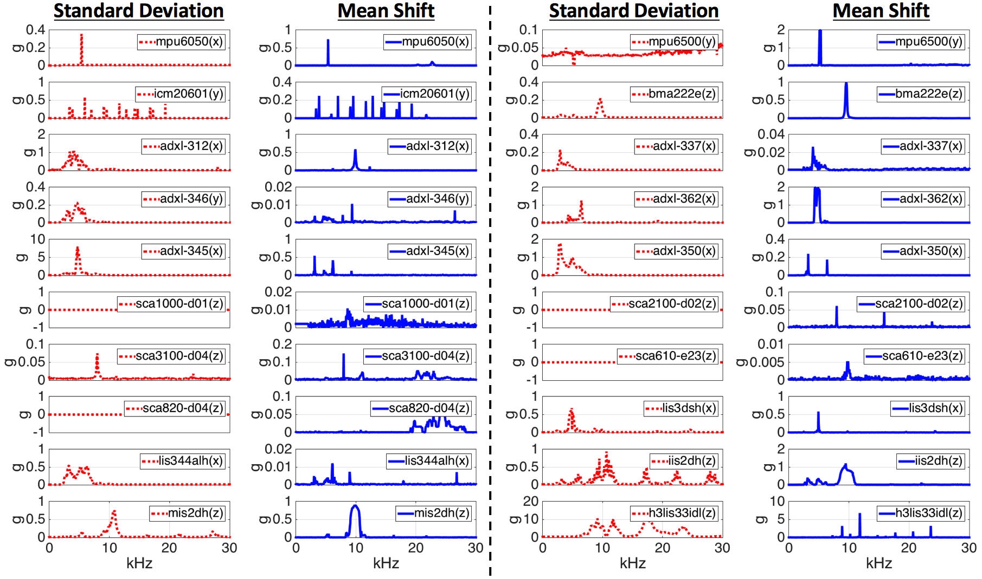
1. Fluctuating
2. Constant
Output Biasing Attack
Output Control Attack
Standard Deviation
Mean Shift

Slide 10
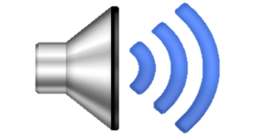
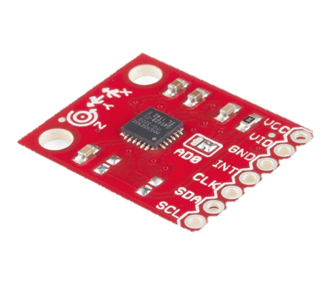
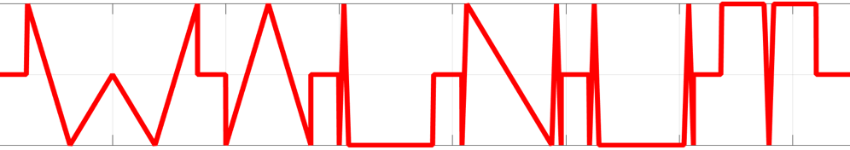
Controlling the Output of an Accelerometer

Slide 11
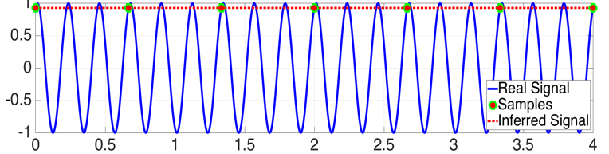
Output Biasing: (1) Stabilize Spoofed Measurements
ADC
Nyquist
Analog Accel. Signal
Digital Accel. Signal

Slide 12
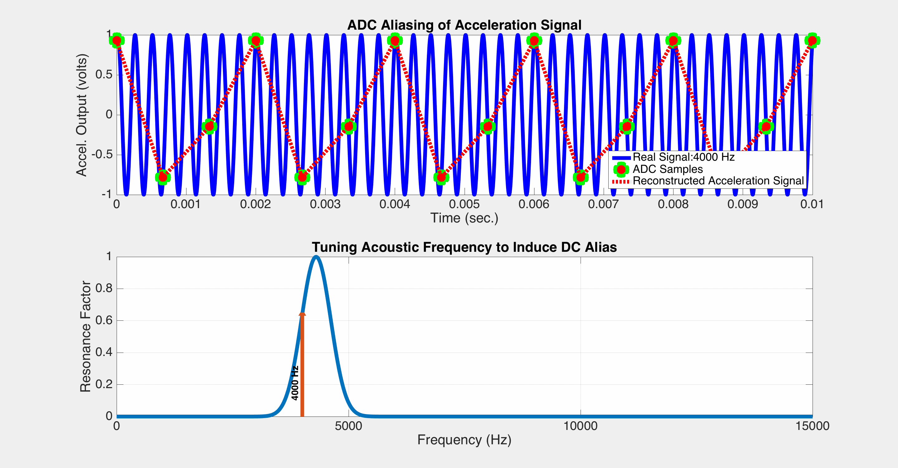
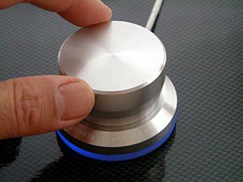
t
t
……….

Slide 13
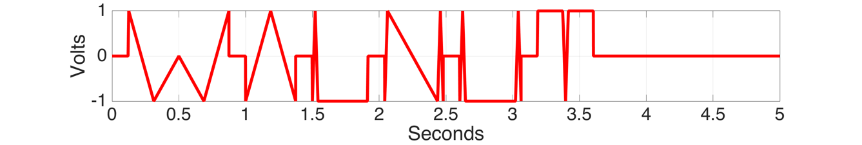
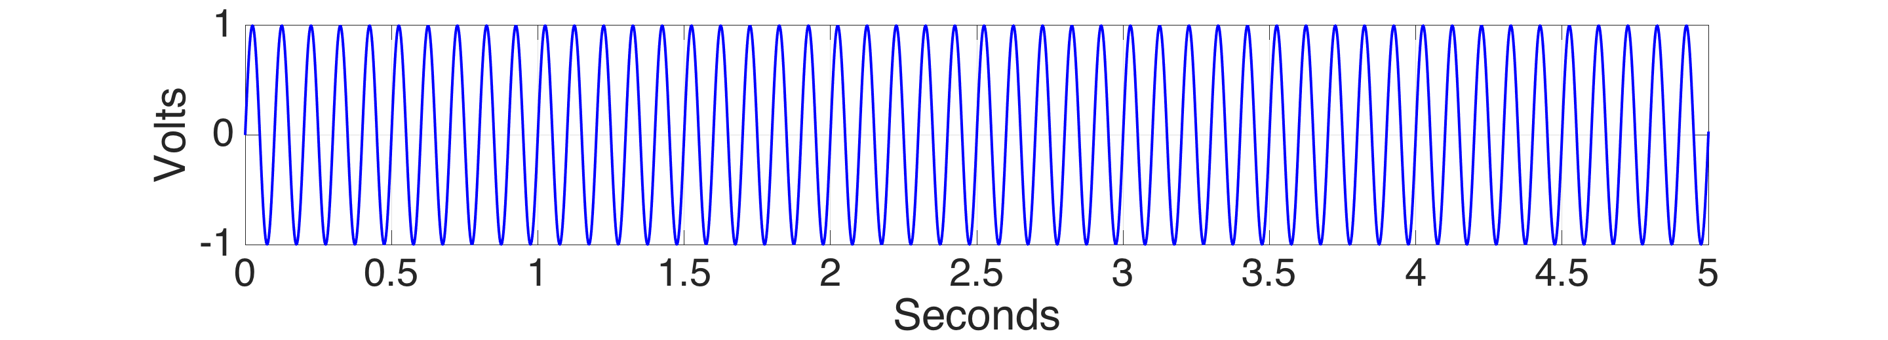
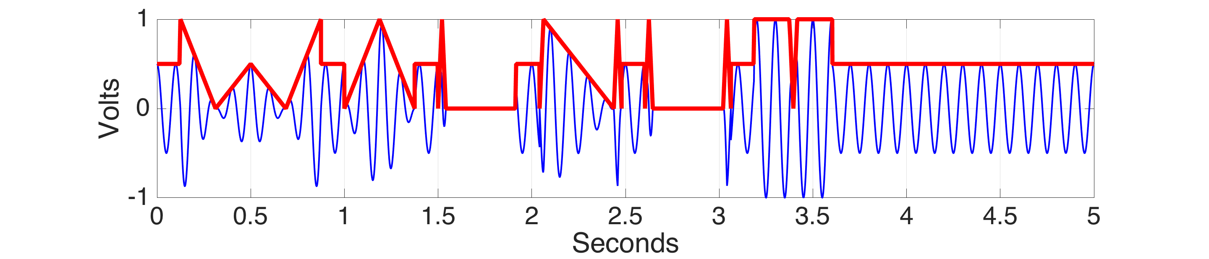
Output Biasing: (2) Shape Desired Output Signal
Desired Accelerometer
Output Signal
+
MEMS Resonant Frequency
(Carrier Signal)
=
Modulated Acoustic
Attack Signal

Slide 14
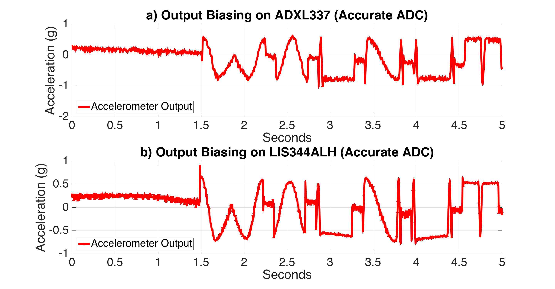
W
A
L
N
U
T
W
A
L
N
U
T

Slide 15
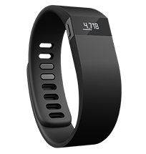
Altering System Behavior through its Accelerometer

Slide 16
Samsung Galaxy S5
Smartphone is ideal target → speaker and accelerometer COLOCATED!
Phone application uses accelerometer to maneuver an RC car
Application: iSpy Toys
Accelerometer: MPU6500
Orientation of Phone X-axis vs. Car Actions
Spoof Phone Orientation with Acoustics!
X-axis
X-axis
Car Commands
X-axis
RC Car
1g = Backward
0.3g = Stop
0g = Forward
Notes:
****Proof of Concept****

Slide 17
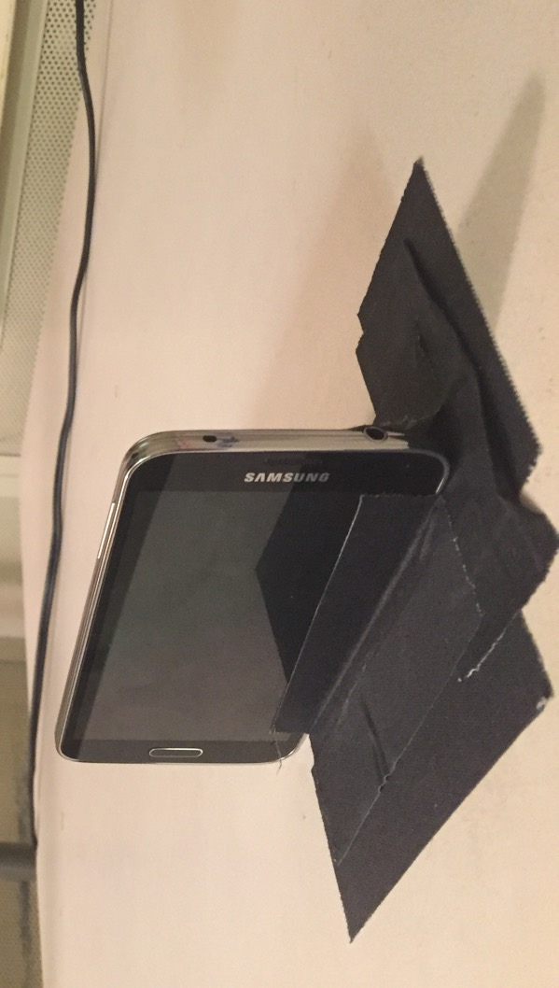
Samsung Galaxy S5
Car Commands
RC Car
Accelerometer Readings
Samsung Galaxy S5

Slide 18
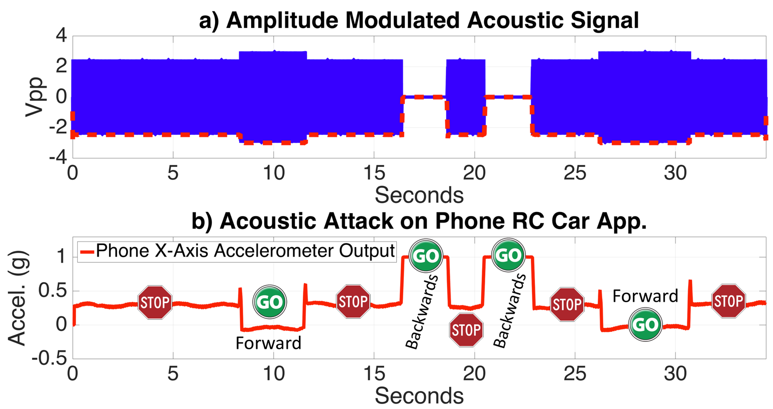
Samsung Galaxy S5

Slide 19
Defending Accelerometers Against Acoustic Attacks

Slide 20
Defending Against the Adversary
Hardware
Increase Difficulty
Increase Difficulty
Prevent
Prevent
Software
Increase Difficulty
No Benefit
Increase Difficulty
No Benefit
Notes:
Low-Cost Software Filtering

Slide 21

Randomized Sampling
Destroy predictability of sampling regime
Add random delay (w.r.t. F_{res}) to beginning of each sampling interval
t+r₁
t+r₂
t
t
t+r_{n}
Step 1: Stabilize Spoofed Measurements
t
……….
……….
Randomized Sampling
Notes:
What do we know?
Accelerometers can only be spoofed at its resonant frequency
Resonant frequencies are known at design time
F_{s} = 2550 Hz → ~ 0.4ms
F_{res} = 5100 Hz → ~ 0.2ms

Slide 22
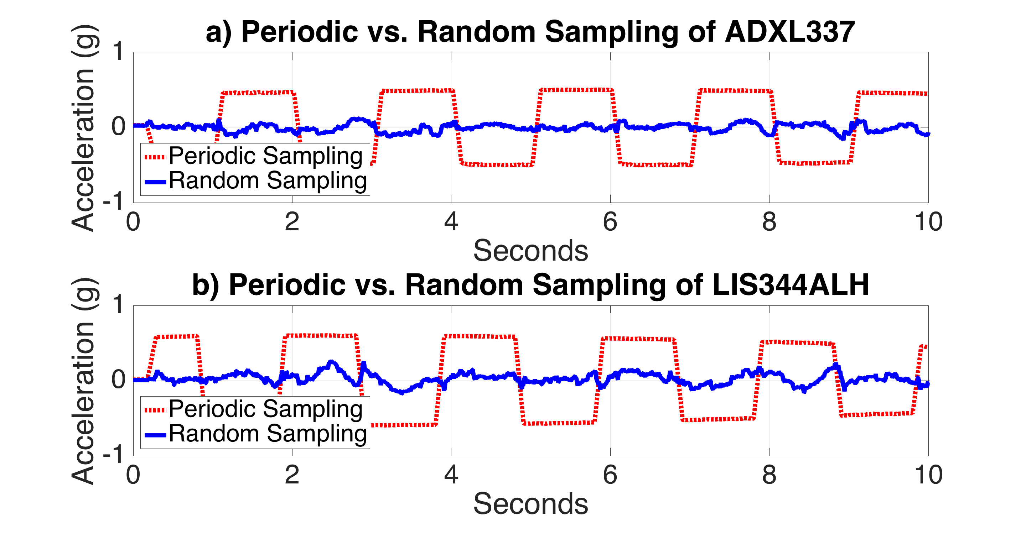
Randomized Sampling

Slide 23
Conclusions
Found 85% MEMS accelerometers models affected by acoustics
Spoofed sensor data can be controlled by an adversary
Adversaries can control autonomous systems
Demonstrated how to mitigate acoustic attacks on MEMS accelerometers
Need to have security in mind when designing sensor hardware

Slide 24
Questions?
Tim Trippel
trippel@umich.edu
For demo videos please visit: https://spqr.umich.eecs.edu/walnut

Slide 25
Coordinated Disclosure
Notified all affected semiconductor manufactures
Analog Devices
Bosch PSIRT
InvenSense
STMicroelectronics
Murata
Notified U.S. Department of Homeland Security ICS-CERT to coordinate disclosure with affected device manufactures
Notified device manufactures
Fitbit
Samsung
See project website for more details (https://spqr.eecs.umich.edu/walnut)

